Slide 1

PRISM’S Loyalty Program

Slide 2

Executive Summary
Objective: This report highlights key insights and recommendations on the Prism+ loyalty program
Key takeaways
The coupons and discounts drive revenue through repeat purchases but impact profitability. Going forward, I recommend two solutions:
Solution 1: Discontinue the loyalty program. Prism can save over £22K cost from excessive discounts to Prism Plus customers.
Solution 2: Continue the loyalty program. Adjust the discount rate for each Prism tier group + Gradual Phase-Out of High-Discount Coupon (40%OFF 50%OFF). Offer Prism plus members non-discount benefits. Through this adjustment, Prism can potentially save over £12k while maintaining customer loyalty.
Notes:
Aim - Telling Stories
Objective - holistic view of the potential opportunities to improve profit for Prism.

Slide 3
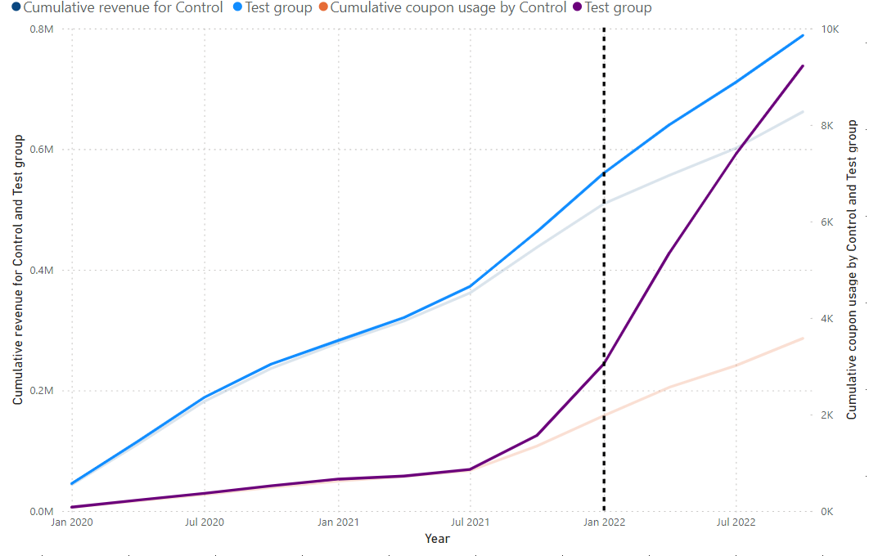
Coupon Power Surge: Driving Revenue Growth
Insights: The use of coupons by Prism tier plus customers skyrocketed after the launch of the Loyalty program.
Launch

Slide 4
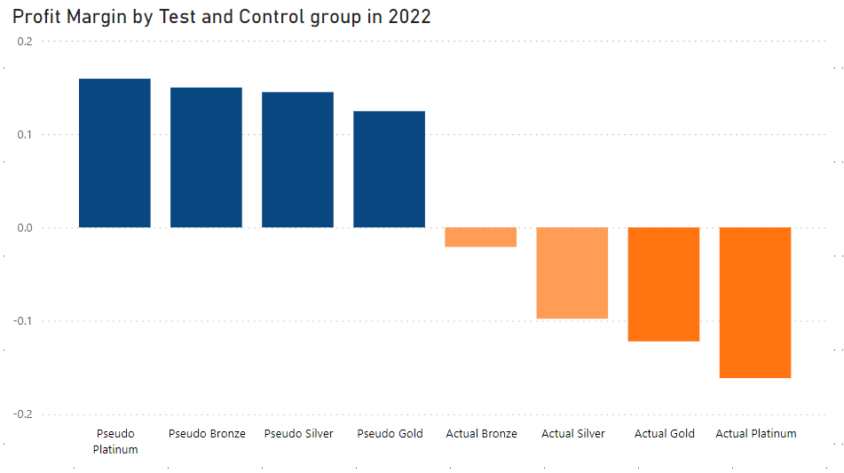
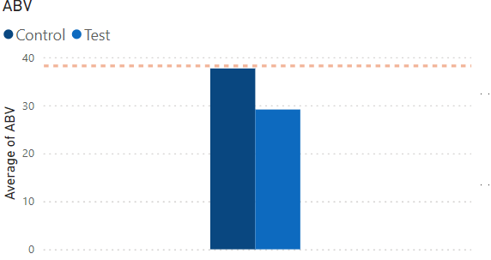
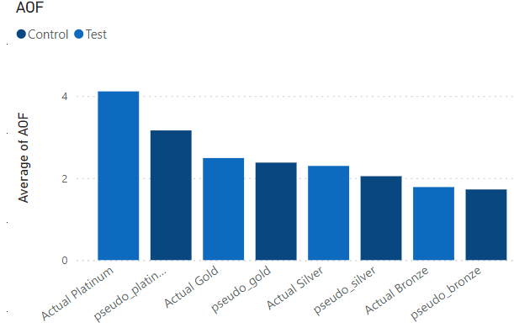
Despite revenue increasing for Prism plus tier members, the profit margin remains negative
Insights: The loyalty program performs better in some metrics but worse off in others

Slide 5
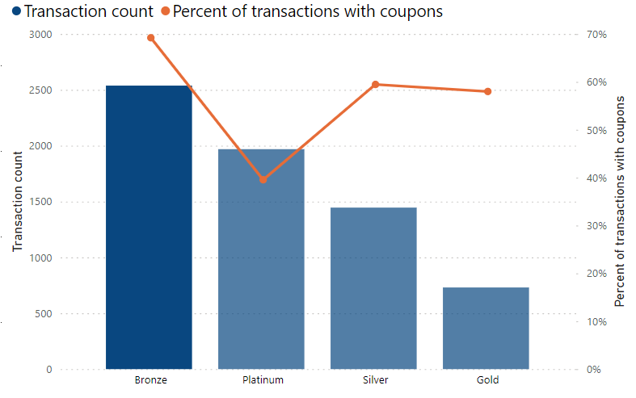
Bronze customers lead the Pack in Coupon Usage
Over 40% of transactions completed with coupon usage by Bronze customers
Recommendation: Discontinue the loyalty program
Financial impact: Over £22K can be from saved excessive discounts to Prism plus customers

Slide 6
Adjusted loyalty structure could save Prism over £10k in discounts alone.
Recommendation: Adjust the discount rate for each Prism tier group + Gradual Phase-Out of High-Discount Coupon (40%OFF 50%OFF). Offer Prism Plus members early access to product launches and sales.
Implications: Reducing the discount rate for each Prism plus tier group will improve profitability and could save Prism over £10k while still maintaining customer loyalty.
Early access to product launches and sales could drive early sales and boost engagement.

Slide 7
Conclusions
Key takeaways
The coupons and discounts drive revenue through repeat purchases but impact profitability. I recommend two solutions:
Solution 1: Discontinue the loyalty program. Prism can save over £22K cost from excessive discounts to Prism Plus customers.
Solution 2: Continue the loyalty program but reduce the discount rate for each Prism tier group. Offer Gold and Platinum members additional non-discount benefits with early sales and product launch perks.
Through this adjustment, Prism can potentially save £12k+ in tiered discounts alone.
Notes:
Aim - Telling Stories
Objective - holistic view of the potential opportunities to improve profit for Prism.

Slide 9
Coupon Power Surge: Driving Net Profit Growth
The question is how we balance customer retention and profitability in a tiered loyalty program
Maintain as it is
Cancel it entirely
Try the Adjusted structure with a new discount percent
Maintain the loyalty program
Adjust discount structure + non-discount benefits
Early access to new products (Platinum)
Free expedited shipping
Double points on all purchases
Early access to sales ( Gold)
Free standard shipping
1.5x points on all purchases

Slide 10
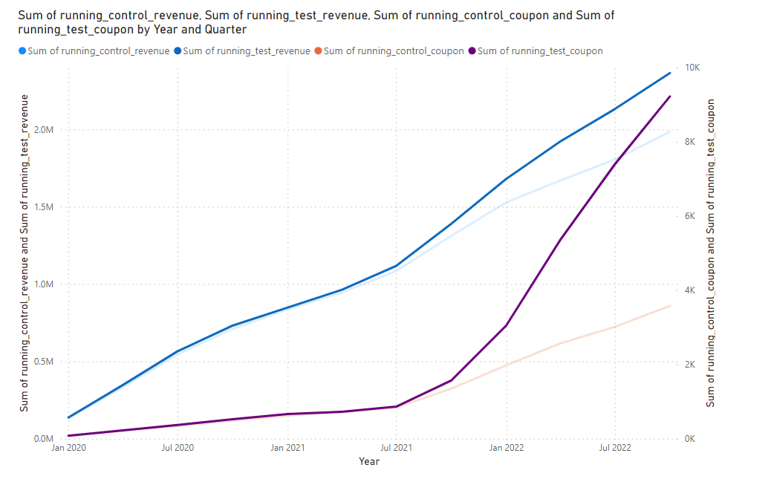
Coupon Power Surge: Driving Net Profit Growth
Revenue climbs sharply with coupon offerings.
After the launch revenue climbs shaper.

Slide 11
